Slide 1
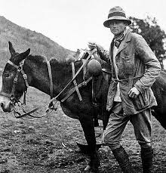
Team idol….Hiram Bingham – a real life Indiana Jones
RGB Explorers
“Getting beyond the pretty pictures”
Notes:
Brief intro detailing who we are: never met – two mathematicians, two crazy about coding, two virgin geologists, in coding then…
Emphasise the commerciality – how could we implement this – data room screening tool etc

Slide 2


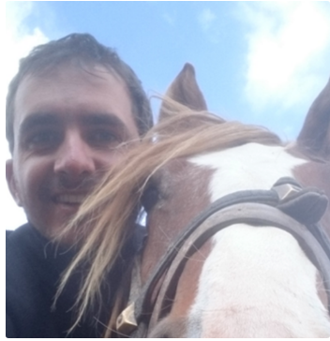


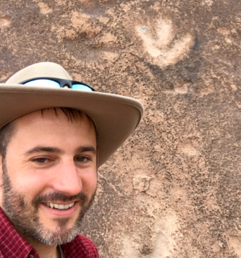
RGB – Explorers team
Steve Purves (Euclidity) Code + signals
Gijs Straathof (SGS) Geophysicist
Julien Cap (Total) Programmer
Florian Smit (Copenhagen Uni) Geologist
Thomas Gazzola (Total) Programmer
Tom Sandison (Shell) Geologist

Slide 3
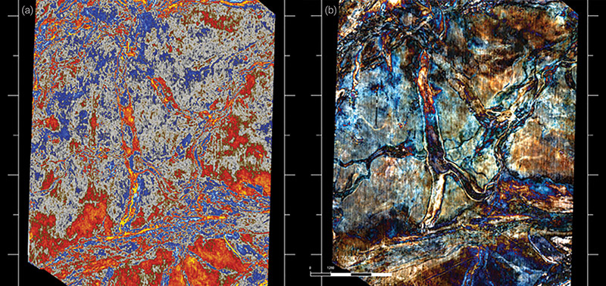
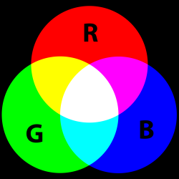
Seismic amplitude (a) and 3x time
frequencies RGB horizon blend (b)
The What?
*AAPG explorer January 2014, Rongfeng Zhang
20 Hz
30 Hz
1. In seismic amplitude data “geology” is difficult to observe
2. In RGB blended data – in this case blended frequencies – “geology” pops out…..

Slide 4
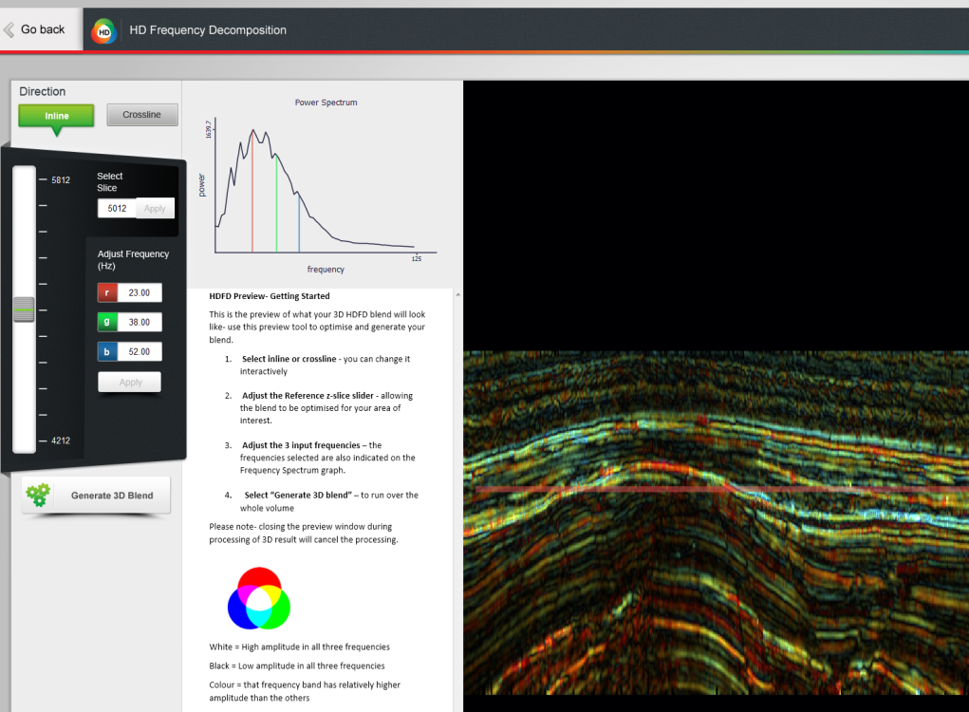
Present approach to SpecDecomp in RGB
Present-workflow ‘Trial and Tweak’
Seismic
R(Hz), G(Hz), B(Hz) (freq/time)
RGB Image
Well (depth/time domain) Different domains!
Translation to geology
Place well data into image

Slide 5
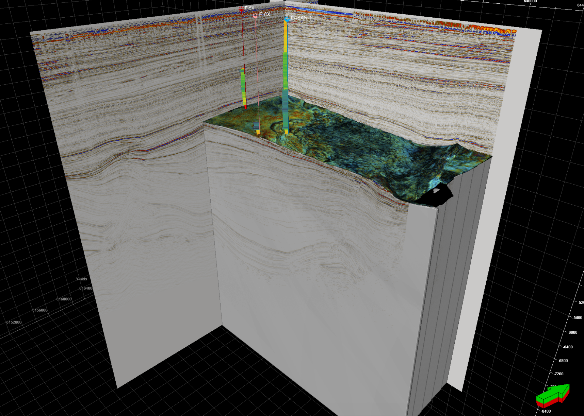

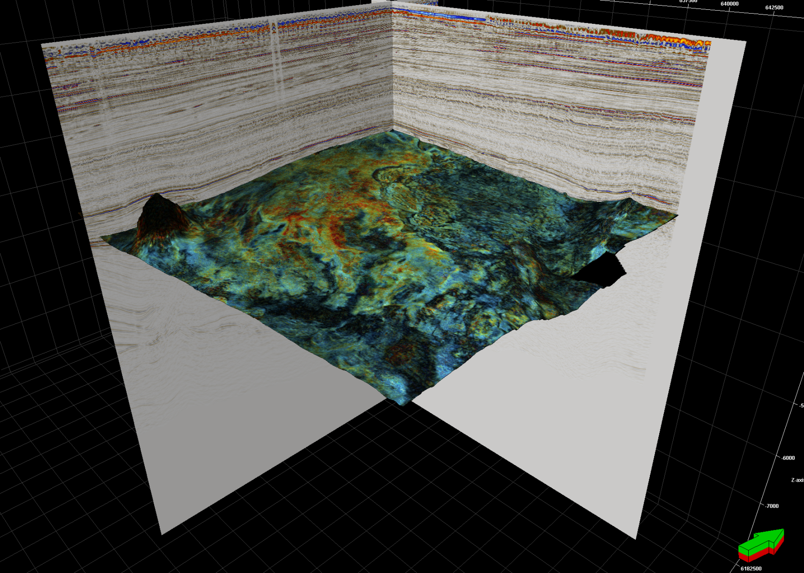
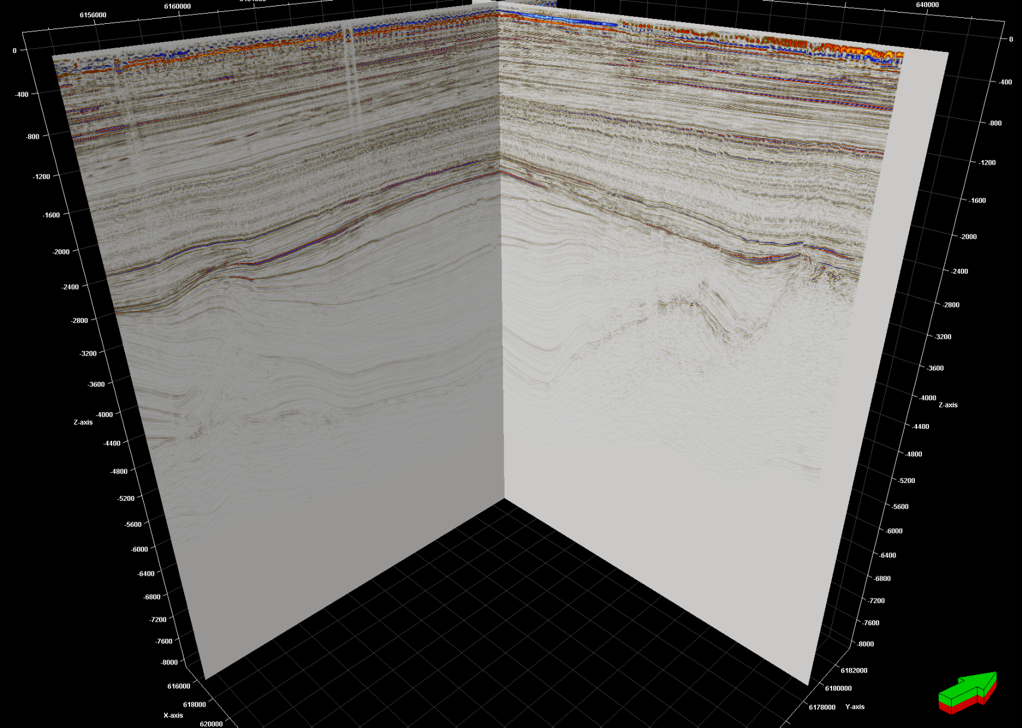
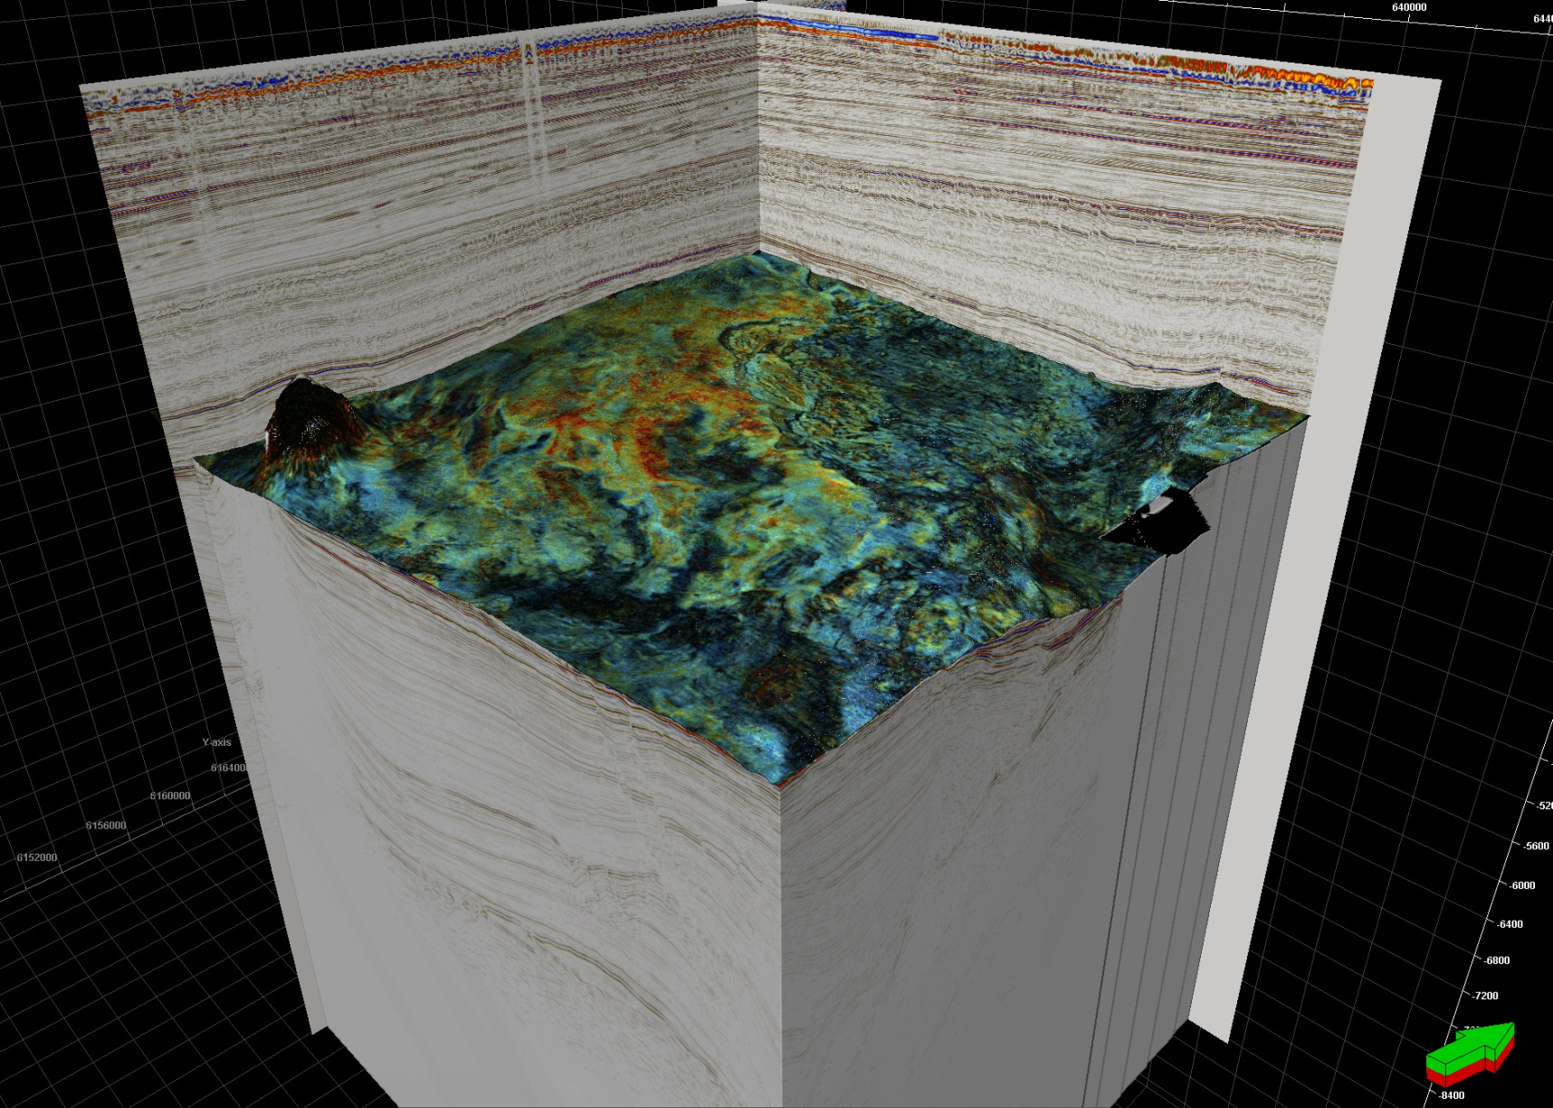
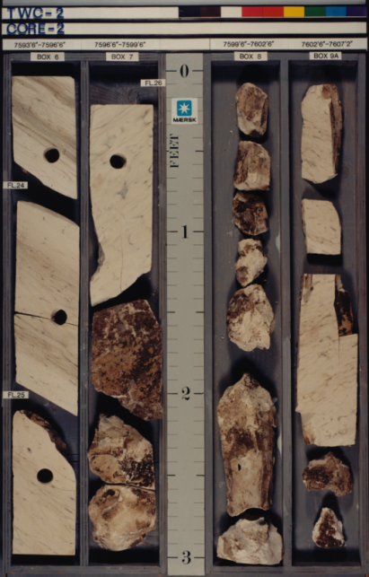
Typical workflow to investigate seismic features
Elements:
Seismic amplitude
PaleoScan surface
GeoTeric Spectral decomposition or eXchroma
Anatomy: Horizon probes and Box sculpting probes (Petrel)
Well logs (Petrel)
Core data (core-lab)

Slide 6

The Why?
The standard workflow aka “Trial & Tweak”
Seismic
RGB
Well
← Standard
Smit et al. 2018
RGB Explorers fork: Start workflow at the well (where ‘real geology’ is)

Slide 7
A different approach to RGB
Present-workflow ‘Trial and Tweak’
Seismic
R(Hz), G(Hz), B(Hz) (freq/time)
RGB Image
Well (depth/time domain) Different domains!
Translation to geology
RGB Explorers workflow ‘Educated guess + consistent domains’
Well (depth to time to frequency domain)
RGB well log in R(Hz), G(Hz), B(Hz) (freq/time)
Seismic (same parameters as well)
RGB Image + RGB well log
Same domains!
Translation to geology
Automated optimization in ZOI
Place well data into image
Place well data into image
Same domains!

Slide 8
Live Demo Time

Slide 9
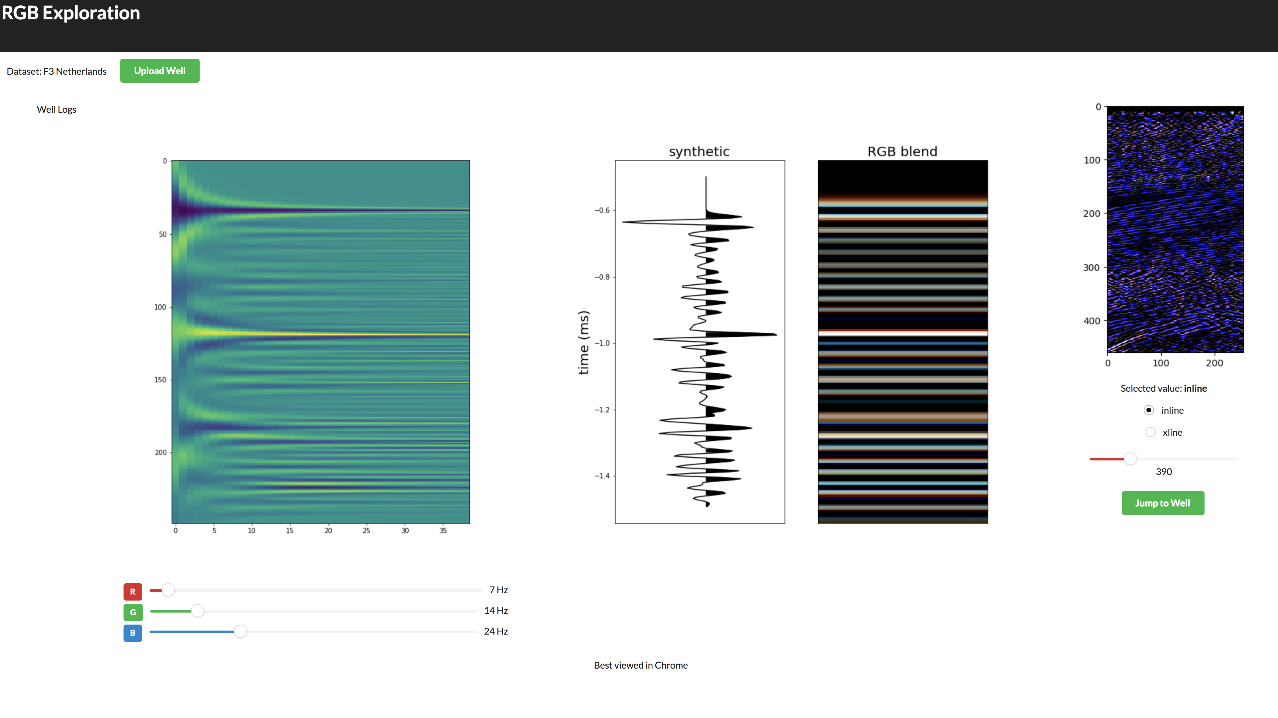
Seismic
GR DT

